Slide 1
Disorders of CHO metabolim
By
Dr.Qutaiba A. Qasim
Ph.D Clinical Biochemistry
2020

Slide 2
Subjects at risk of developing diabetes mellitus
1-strong family history of diabetes mellitus
2-autoimmune disease
3-obesity
4-sedentary life style
5-gestational diabetes
6-prediabetes
7-Age over 45 years
8-stress

Slide 3
Metabolic features of diabetes mellitus
Patients with type 1 diabetes tend to be diagnosed before the age of 40 years, are usually lean and have experienced weight loss at the time of presentation. They may present with diabetic ketoacidosis. Conversely, patients with type 2 diabetes often present later, usually after the age of 40 years, and are often overweight or obese.

Slide 4
Long-term effects of diabetes mellitus
1-Macrovascular disease due to abnormalities of
large vessels may present as coronary artery, cerebrovascular or peripheral vascular insufficiency. The condition is probably related to alterations in lipid metabolism and associated hypertension. The most common cause of death is cardiovascular disease, including myocardial infarction.

Slide 5
Long-term effects of diabetes mellitus
2-Microvascular disease due to abnormalities of small blood vessels particularly affects the retina (diabetic retinopathy) and the kidney (nephropathy); both may be related to inadequate glucose control.
3-Infections
4-Diabetic ulcers

Slide 6
Monitoring of diabetes mellitus
1-Glycosuria
2-Blood glucose
3-Glycated haemoglobin (HbA1c) gives a retrospective assessment of the mean plasma glucose concentration during the preceding 6–8 weeks.
4-Fructosamine assess glucose control over a shorter time course than that of HbA1c (about 2–4 weeks

Slide 7
Monitoring of diabetes mellitus
5-Blood ketones
6-Urinary albumin

Slide 8
Acute metabolic complications of diabetes mellitus
1-Hypoglycaemia
2-Diabetic ketoacidosis
3-Hyperosmolal non-ketotic coma(HONK)
4-Lactic acidosis

Slide 9
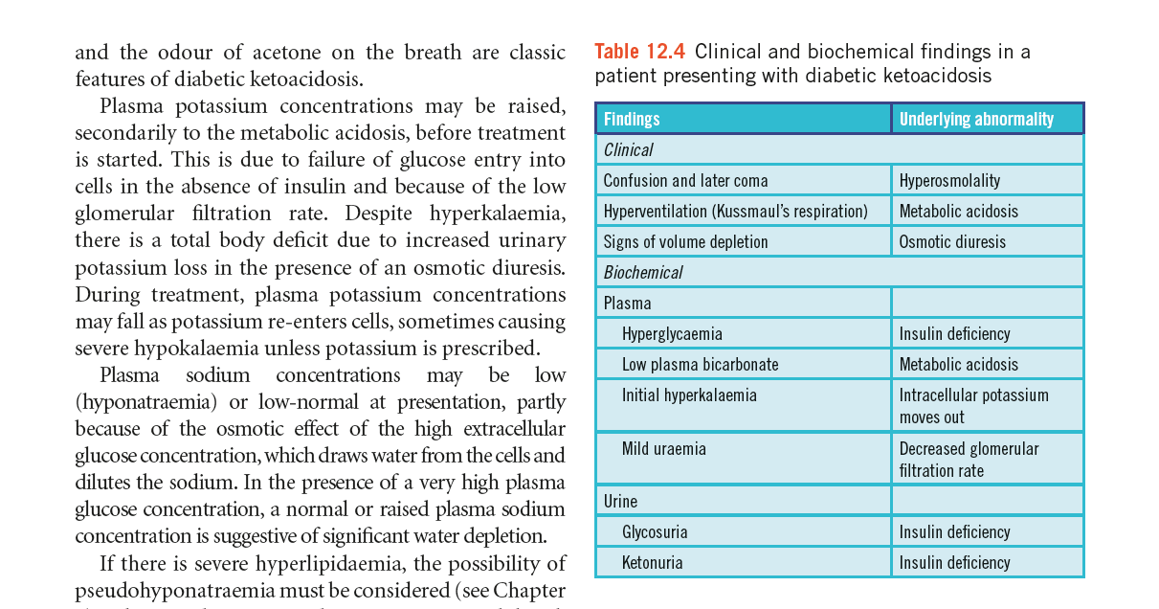

Slide 10
Principles of treatment of diabetic coma
1-Hypoglycaemic coma needs prompt glucose replacement to avoid irreversible brain damage, for example 50 mL of 20 per cent glucose intravenously. If intravenous access is not an option, glucagon 1 mg can be given
intramuscularly. Once the patient is awake, glucose containing drinks can be given.

Slide 11
Principles of treatment of diabetic coma
2-Diabetic ketoacidosis : Repletion of fluid and electrolytes should be vigorous. A 0.9 per cent normal saline solution should be administered. If the plasma glucose concentration is more than 20 mmol/L, 10 U soluble insulin should be given. If the metabolic acidosis is very severe (pH less than
7.0), bicarbonate may be infused .

Slide 12
Investigation of suspected diabetes mellitus
Diabetes mellitus is confirmed if one of the following is present:
a fasting venous plasma concentration of 7.0 mmol/L or more on two occasions or once with symptoms, or
a random venous plasma concentration of
11.1 mmol/L or more on two occasions or once with symptoms.

Slide 13
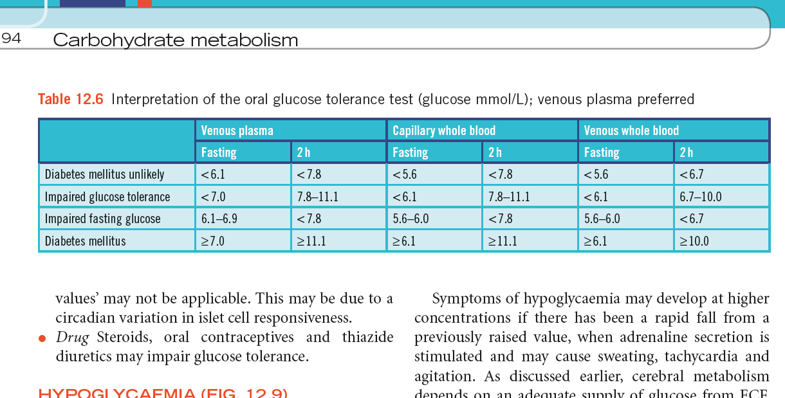

Slide 14
HYPOGLYCAEMIA
if the plasma glucose concentration is less than 2.5 mmol/L in a specimen collected into a tube containing an inhibitor of glycolysis, for example fluoride oxalate.
Blood
cells continue to metabolize glucose in vitro, and low
concentrations found in a specimen collected without
such an inhibitor can be dangerously misleading
(pseudohypoglycaemia).

Slide 15
Hyperinsulinaemic hypoglycaemia
Inappropriately high insulin concentrations due to: Pancreatic tumour – insulinoma Hyperplasia of the pancreatic islet cells Insulin receptor antibodies Autoimmune insulin syndrome Exogenous insulin Sulphonylureas, meglitinides

Slide 16
Hypoinsulinaemic hypoglycaemia
1-Endocrine : Glucocorticoid deficiency/adrenal insufficiency , Severe hypothyroidism ,Hypopituitarism
2-organ failure : Severe liver disease , End-stage renal disease , Severe congestive cardiac failure
3-Some non-pancreatic islet cell tumours Insulin-like growth factor (IGF)-2-secreting tumours, e.g. liver, adrenal, breast, Leukaemias, lymphomas

Slide 17
Reactive hypoglycaemia
Idiopathic
Post-gastric surgery
Alcohol induced
Miscellaneous causes
Von Gierke’s disease (type 1 glycogen storage disease)
Drugs, e.g. salicylates, quinine, haloperidol,
pentamidine, sulphonamides

Slide 18
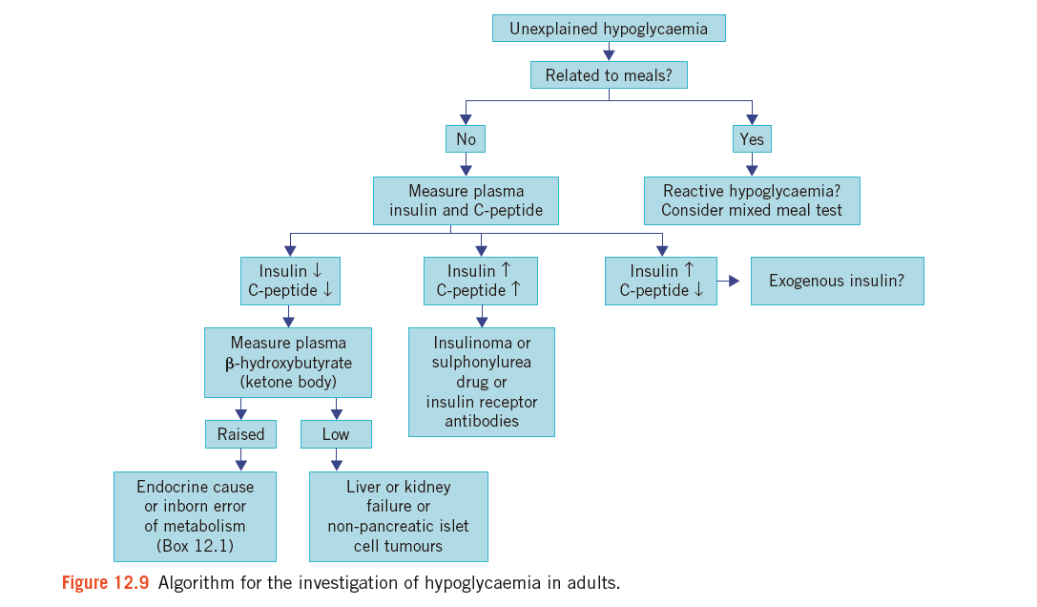

Slide 19
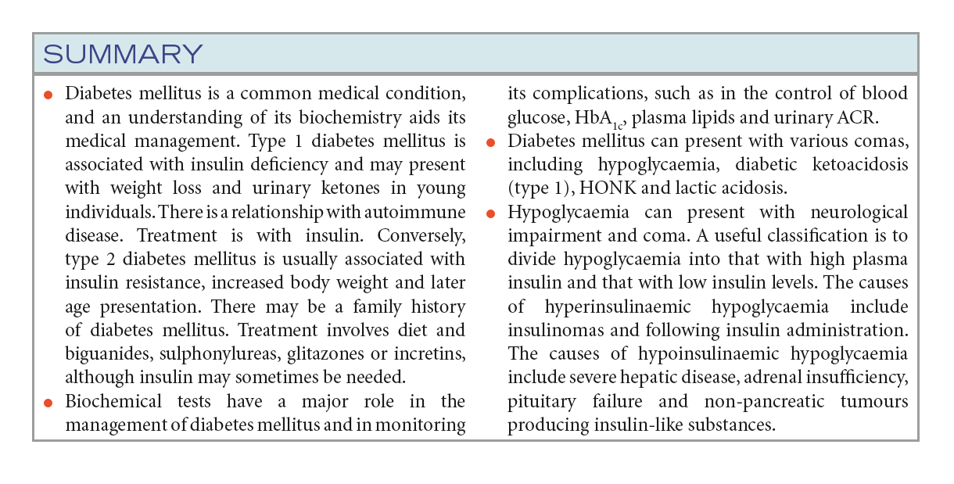

Slide 20
END OF LECTURE THANKS FOR LISTENING

